Slide 1
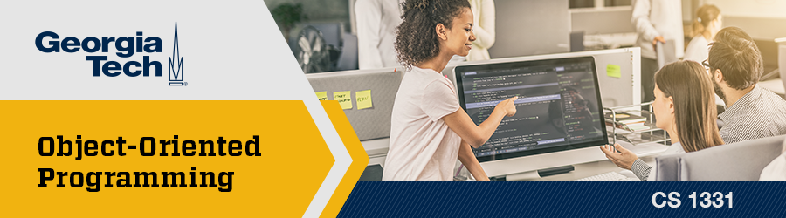
Recitation 9 /////

Slide 2
Georgia Tech Academic Resources
Academic Resources:
Office Hours
Success Summit
Academic Coaching
Free 1-to-1 Tutoring
PLUS sessions
Compilation of all academic resources: here
Mental Health Resources:
Peer Coaching
Counseling Appointments
Psychiatry Appointments
Group Therapy sessions
Compilation list of all mental health resources: here
Disability Resources:
Office of Disability Services
Dean of students
Professor’s Compilation of Resources:
National Resources and Campus Resources

Slide 3
Announcements
HW04 due this Thursday (10/21)
HW05 released this Friday (10/22) and due next Thursday (10/28)
How was Exam 2?

Slide 4

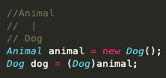
Topic Trivia
Given the following line of code, what are the static and dynamic types of the object dog?
(T/F) A class can only implement one interface.
3. (T/F) Upcasting will always compile but not run.
4. Given the following class hierarchy, what type of
cast occurs in the last line? Is it valid?
5. Does Java run the methods of the dynamic type
or static type of an object?

Slide 5
Topic Trivia
Given the following line of code, what are the static and dynamic types of the object dog?
(T/F) A class can only implement one interface
3. (T/F) Upcasting will always compile but not run
4. Given the following class hierarchy, what type of
cast occurs in the last line? Is it valid?
5. Does Java run the methods of the dynamic type
or static type of an object?
Static: Animal; Dynamic: Dog
False – can implement many
False
Downcast; it is valid
Dynamic

Slide 6
Topics List
Abstract classes (already covered on Exam 2 but refresher for Polymorphism)
Polymorphism
Interfaces

Slide 7
Abstract Classes
Classes that cannot be instantiated
Used to define common attributes (instance data) and behaviors (methods) for other subclasses
"Template" or "Contract" for behaviors that subclasses of the Abstract Class must follow
An abstract Class is declared using the abstract keyword

Slide 8
Abstract Classes (continued)
Can have abstract methods
No implementation needed, just the method header
Must be overridden when inherited by a concrete class
Cannot be static or final or private
Can have constructors, non-abstract methods, and instance variables

Slide 9
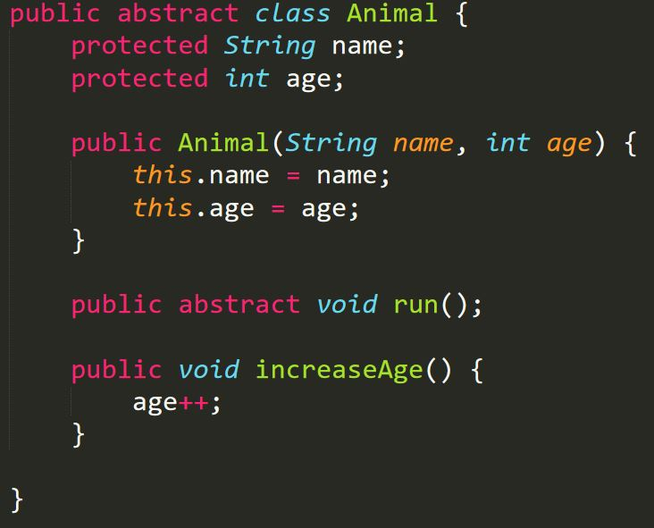
Abstract Classes (continued)
Remember that an Abstract class cannot be instantiated. Therefore doing
Animal a = new Animal("Dog",12) will give a compiler error

Slide 10
Why use Abstract Classes?
Reuse code for similar interpretations (same concept as Inheritance)
Not every class needs to be instantiable:
We do not want a user to create Animal Objects because Animal is a very generic type
We want Dog or Cat Objects instead of Animal
We want Dog and Cat objects to then have common characteristics an Animal should have

Slide 11


Polymorphism
Describes the ability of an object to behave differently based on the context of the action
Has to do with the idea of inheritance
Person
Student
Teacher

Slide 12
Using Polymorphism
Person p1 = new Person();
Student s1 = new Student();
Person p2 = new Student();
Object o1 = new Person();
Object o2 = new Student();
Student s3 = new Person();
Static type
On the left of the assignment operator
Dynamic Type
On the right side of the assignment operator
The dynamic type should have an "is-a" relationship with the static type
A person "is-a" person, a student "is-a" person, etc.
This is wrong because a Person is not always a Student

Slide 13

Polymorphism and Methods
At compile time, Java checks if the method exists in the static type
Does study() exist in Person?
At run time, Java runs the method specified in the dynamic type
If study() is implemented in both Person and Student, it will run the implementation from Student.

Slide 14


Polymorphism and Methods (cont.)
Method calls take precedence over casting
Casting the result of getAge()to a Student
Casting p1 to a Student object and calling getAge()on the casted object

Slide 15
Polymorphism and Casting
Casting temporarily changes the static type of the variable being casted
Does not impact what happens at runtime, just compile time
Upcasting
Casting a subclass to a superclass. Always compiles and runs.
Downcasting
Casting a superclass to a subclass. Always compiles, sometimes runs.
Sidecasting
Casting one subclass to another subclass. Never compiles, never runs.

Slide 16

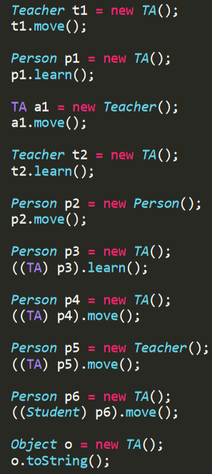
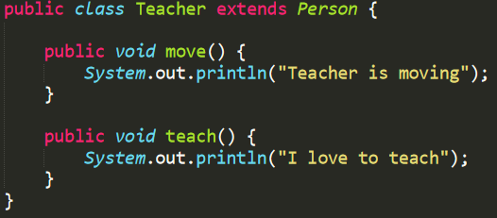
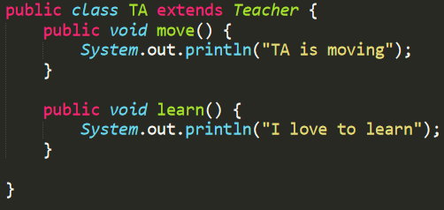
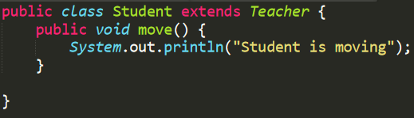
Does the code compile/run? What will it print out?
Compiles and runs.
Prints : "TA is moving"
Static type: Teacher
Dynamic type: TA

Slide 17
Does the code compile/run? What will it print out?
Doesn't compile (learn not found in Person).
Static type: Person
Dynamic type: TA

Slide 18
Does the code compile/run? What will it print out?
Doesn't compile (Teacher is not a TA).
Static type: TA
Dynamic type: Teacher

Slide 19
Does the code compile/run? What will it print out?
Doesn't compile (learn not found in Teacher)
Static type: Teacher
Dynamic type: TA.

Slide 20
Does the code compile/run? What will it print out?
Doesn't compile (Person is abstract)
Static & Dynamic type: Person

Slide 21
Does the code compile/run? What will it print out?
Compiles and runs.
Prints : "I love to learn"
Static type: Person, casted to TA
Dynamic type: TA

Slide 22
Does the code compile/run? What will it print out?
Compiles and runs.
Prints : "TA is moving"
Static type: Person, casted to TA
Dynamic type: TA

Slide 23
Does the code compile/run? What will it print out?
Compiles, but doesn't run.
ClassCastException (Not every Teacher is a TA)
Static type: Person, casted to TA
Dynamic type: Teacher

Slide 24
Does the code compile/run? What will it print out?
Compiles, but doesn't run.
ClassCastException (can’t sidecast)
Static type: Person, casted to Student
Dynamic type: TA

Slide 25
Does the code compile/run? What will it print out?
Compiles and runs.
Calls Object's toString()
Static type: Object
Dynamic type: TA

Slide 26
Interfaces
Another level of abstraction
Defines how a subclass should act; like a contract
Often have –able names as they describe a functionality
Uses the implements keyword
A class can implement more than one interface (but cannot extend more than one class)

Slide 27
Interfaces
Methods are abstract by default
Cannot have instance variables, constructors, or concrete instance methods
Can have static and default methods, and public static final variables (these are optional)
Default methods useful for backwards compatibility
Concrete class that implements an interface MUST override all abstract methods in the interface
Does not have to if class is abstract

Slide 28
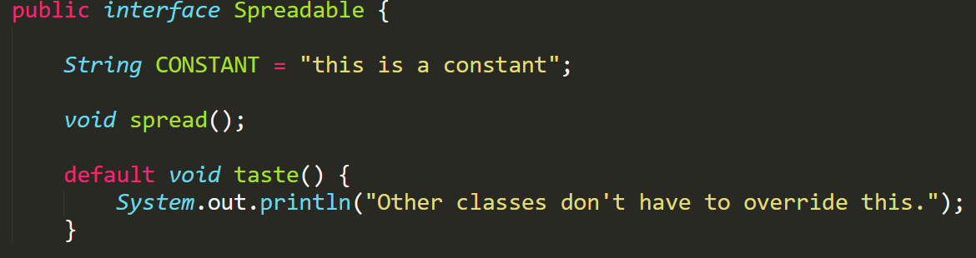
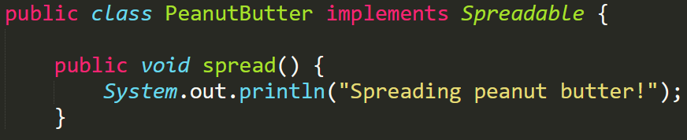
Interfaces
Variables public static final by default
Methods public abstract by default
PeanutButter implements Spreadable so it has to provide a definition for spread

Slide 29
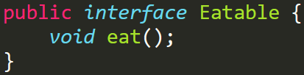
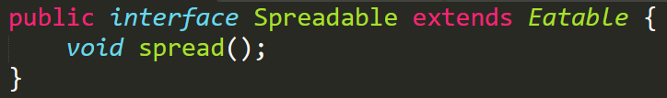
Interfaces
Unrelated classes can implement the same interface (vs. Abstract classes which typically are used in a hierarchy)
Interfaces cannot implement other interfaces, but they can extend other interfaces
Spreadable does not need to provide a definition for eat(), but any concrete class that implements Spreadable will need to override eat() and spread()

Slide 30
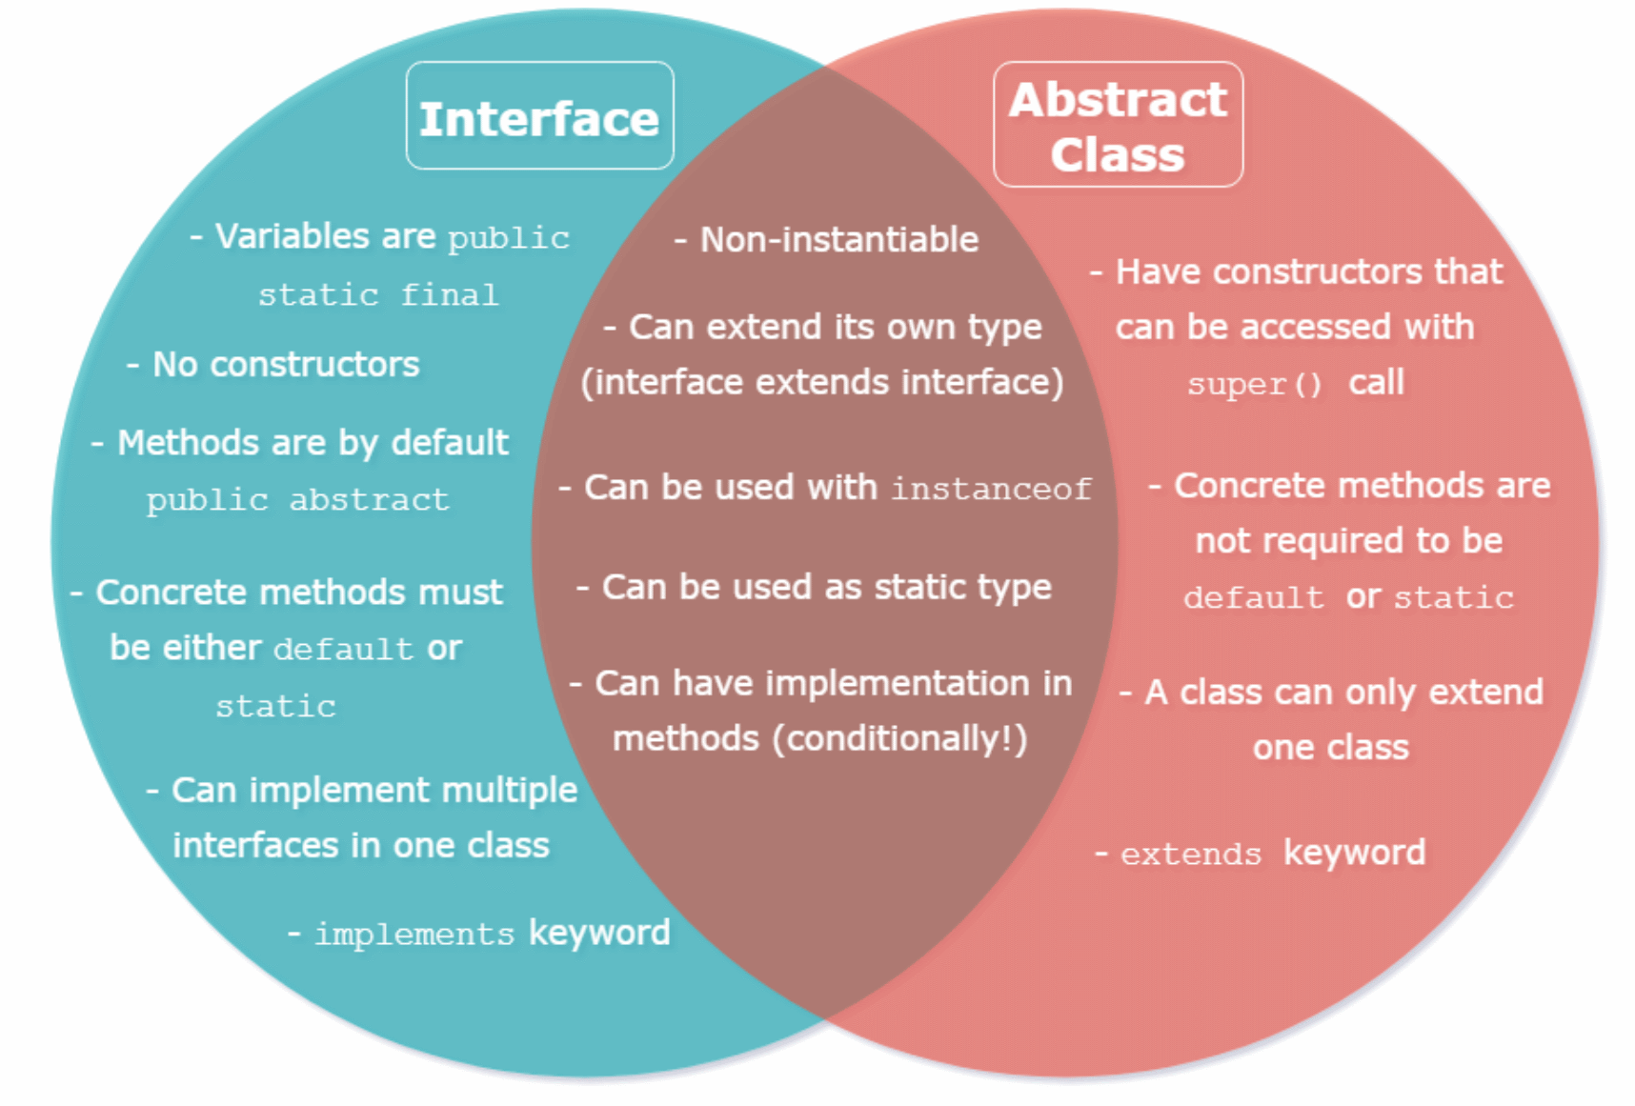
Abstract Classes vs. Interfaces

Slide 31
Comparable
What if we want to compare two objects? Sort an array?
Comparable – any class that implements this means that the objects in that class can be compared (less, greater, equal)
Objects can be compared for order
Not all classes implement Comparable

Slide 32
Comparable
Popular interface; String class implements Comparable!
Any class that implements must have .compareTo() implemented
Important for data structures (if objects can be compared, then they can be sorted according to some standard!)
public int compareTo([class] other) implementation:
Return int < 0 if this is less than other
Return int > 0 if this is greater than other
Return 0 if the two are equal

Slide 33
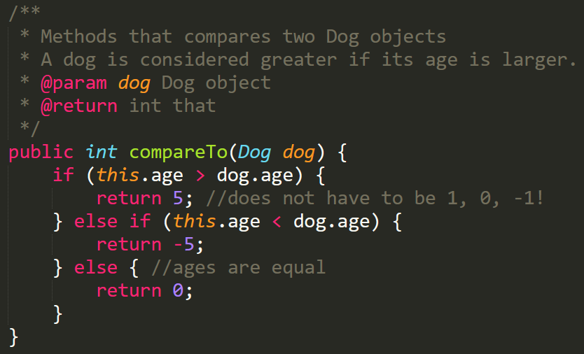
Comparable

Slide 34
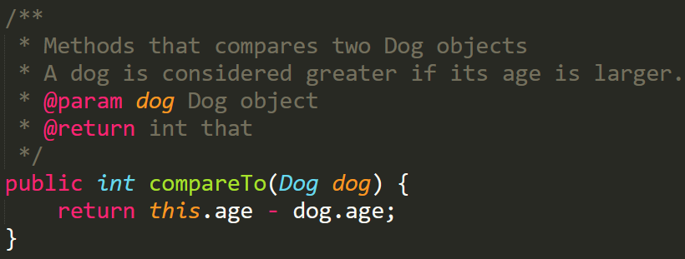
Comparable
More concise way of writing compareTo()

